Slide 1

What effect did the Covid-19 Pandemic have on Streaming Services?
Allie Panacci
Alexander Olvera
Kimberly Kinkade
Tayler Ward

Slide 2


Alexander Olvera
Background
Initially an aspiring theoretical physicist, I began my transition into the digital industry after acquiring my associates. I realized that I loved learning about more than one topic, so I feel Data Science will help me wherever I find curiosity.
Education
- Northeast Lakeview College
Associate of Science - AS, Mathematics (2017 - 2020)
- Woz U
Cyber Security Certificate (2021)
Data Science Certificate (2021 - 2022)

Slide 3





Allie Panacci
I am born and raised in Arizona, currently working and going to school full time. Starting in January 2023, I will be pursuing a Bachelor's degree in Statistics at Arizona State University. I have really found my place in the Data Science field, and it has given me a space to explore my passion for creativity, analysis, and technology.
Education:
Paradise Valley Community College
Associates - Applied Science
(Expected graduation date 2022)
Southern Careers Institute Inc Powered By Woz-U
Certification - Data Science
(2021-2022)

Slide 4
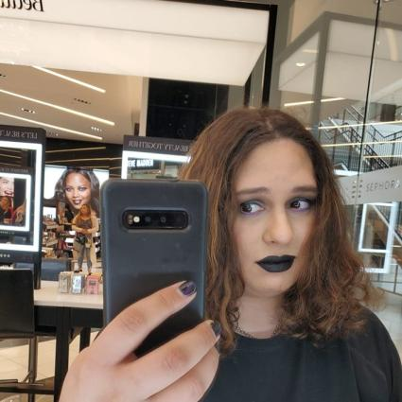




Tayler Ward
Eagle Scout
Army Infantry
Certified Phlebotomist
Certified Medical Assistant
Currently transitioning into tech to pursue my dreams. Cars, Cats, and computers are the things that drive me the most.
Education - Multiple Certificates in medical technology, finishing Data science and starting cyber security.

Slide 5


Kimberly Kinkade
Currently I am in the transportation industry as a Class A Driver and Instructor. I am transitioning to the Tech Industry to have the ability to further my career and spend more time with my family.
I have 15 years of experience in Business Administration.
5 years in Government & Hospital Administration
I am also a proud Navy Mom

Slide 6

Why Covid-19 & streaming services?
We chose this topic because one of the first things that comes to mind when the world enters a quarantine is the activities that you do when you’re at home. One of the first ideas that comes to mind is watching TV shows/movies, through popular streaming services.
With this in mind, we were curious if the streaming services market made a sizeable income due to the entire world entering a mandated “stay at home” quarantine.

Slide 7

The Coronavirus Pandemic
COVID-19 refers to the human infection caused by the new coronavirus strain SARS-CoV-2. While symptoms of many human coronavirus infections are mild, COVID-19 infection symptoms can be serious, even deadly. With Coronavirus cases starting at the end of December of 2019 in Wuhan, China, cases would soon appear across the world. On March 11th, 2020, WHO Declared COVID-19 a Pandemic, and on March 13th, 2020, Trump Declared COVID-19 a National Emergency. On March 15, 2020, the U.S. begins to shut down to prevent the spread of COVID-19.

Slide 8
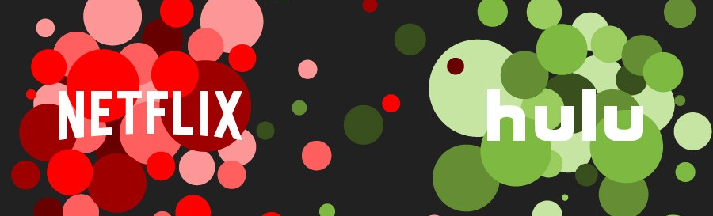
A brief history of Streaming Services
In 2007, Netflix introduced streaming media and video on demand, reaching over 220 million subscribers today.
In 2010, Hulu became a subscription streaming service, featuring full seasons of programs. Today, Hulu has over 45 million subscribers.
Only analyzed Netflix & Hulu because they are top services with public data. Other streaming services rose to prominence due to the pandemic.
HBO Max: May 27, 2020
Disney+: November 12, 2019
Amazon Prime: Added Prime Video in Prime subscription (2011)
However, Amazon Prime is an all-inclusive package the expands beyond streaming services, thus wouldn't be fair or accurate to compare

Slide 9
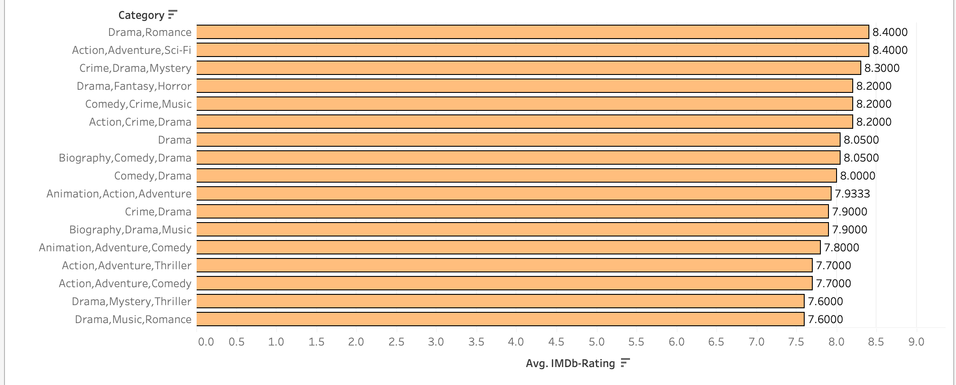
2018 IMDb Category Tier list
1: Drama, Romance
2: Action, Adventure, Sci-fi
3: Crime, Drama, Mystery
Notes:
Pre-pandemic
Highest rated genres: Drama, Romance
Crime Drama

Slide 10
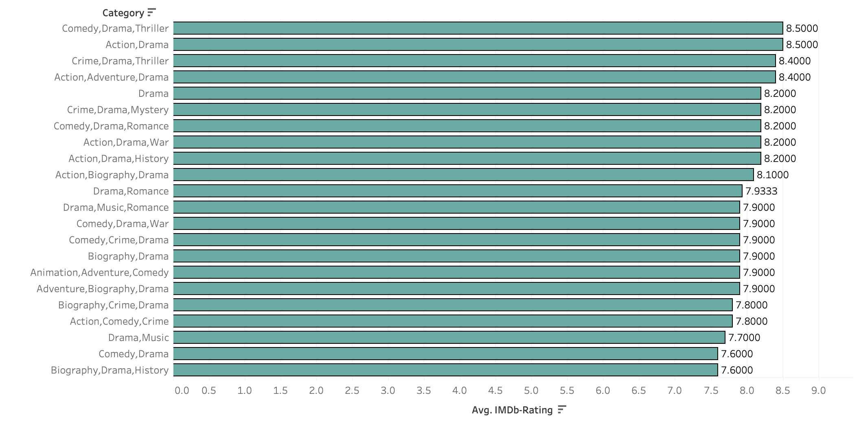
2019 IMDb Category Tier list
1. Comedy, Drama, Thriller
2. Action, Drama
3. Crime, Drama, Thriller
Notes:
Pre-pandemic
Biography Drama rated least

Slide 11
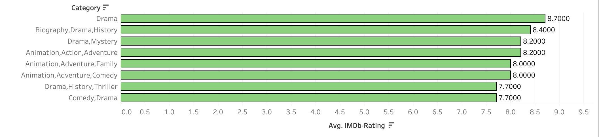
2020 IMDb Category Tier list
1. Drama
2. Biography, Drama, History
3. Drama, Mystery
Notes:
Dramas and Biographies make the top of the list Thrillers and Comedies come in last

Slide 12
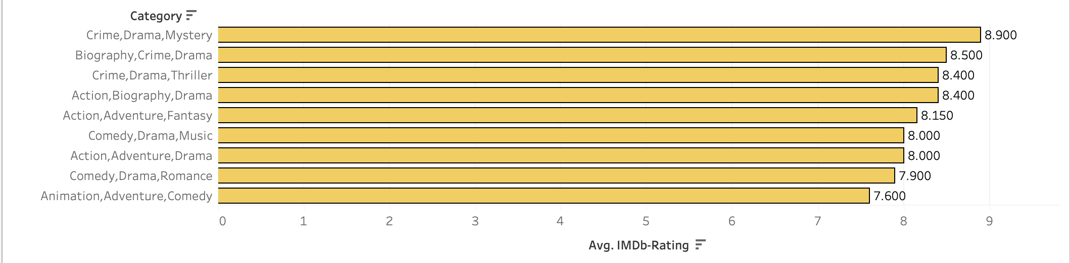
2021 IMDb Category Tier list
1. Crime, Drama, Mystery
2. Biography, Crime, Drama
3. Crime, Drama, Thriller
Notes:
Again Crime dramas and Biographies make the top of the list, while Comedies came in last

Slide 13

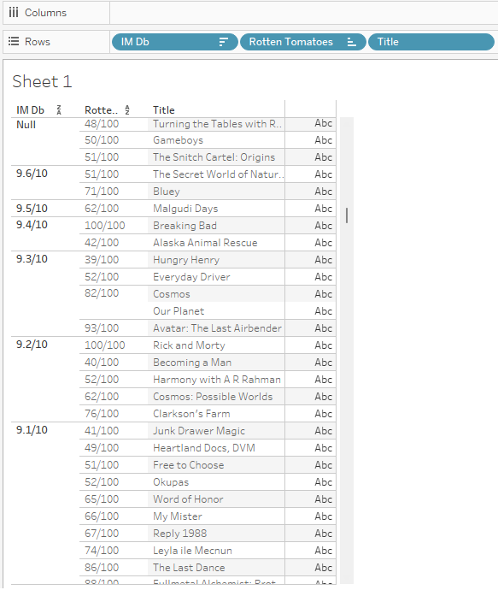
Highest rated TV shows/Movies
Breaking Bad: Crime, Drama
Alaska Animal Rescue: Documentary
Cosmos: Documentary
Avatar: The Last Airbender: Animation, Adventure, Action
Rick and Morty: Animation, Adventure, Comedy
FullMetal Alchemist: Brotherhood: Animation, Action, Adventure

Slide 14

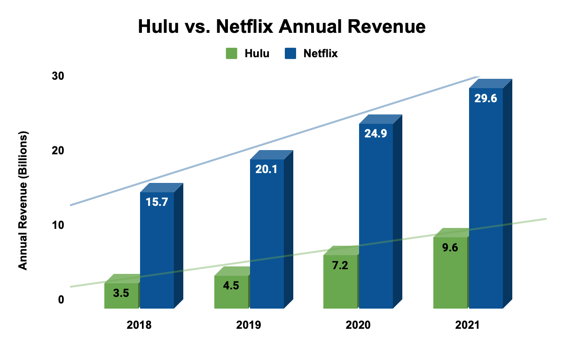
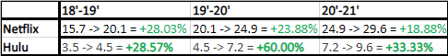


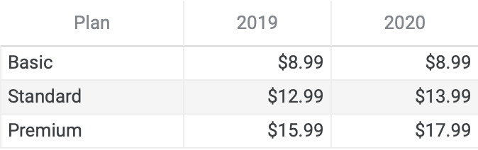
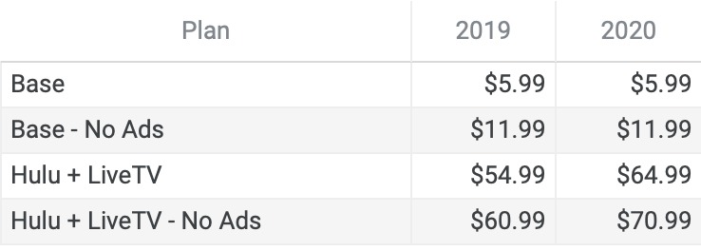
Revenue Growth
Examples of the effect the pandemic had on the streaming service market.
Hulu profit margins, 60% increase in 2020.
Netflix content spending, seemingly steady annual revenue.

Slide 15

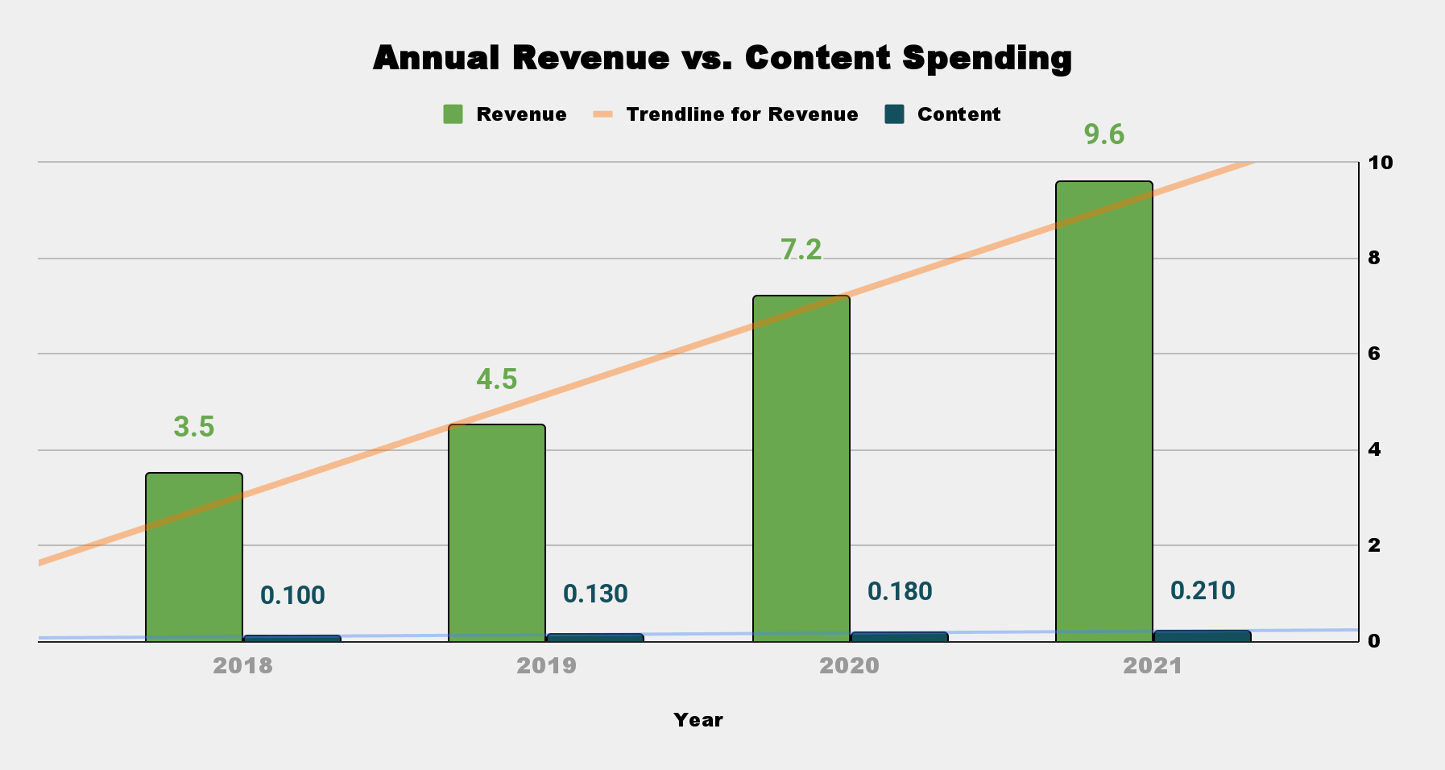
Content Spending - The amount of money spent on original content and acquisition of titles/sports.
Annual Revenue - The amount of money made directly from consumers.
60% revenue increase 2019-2020
($2.7 b).
38% content spending increase 2019-2020 ($50 m).
Pandemic Hits
$5.1 billion made in Annual revenue since pandemic.
$80 million spent on content since pandemic.
Pandemic created a wave of new consumers/revenue.
Unable to and not necessary to spend more on content.
The pandemic created an abundance of customers which ultimately created an immense growth in revenue

Slide 16

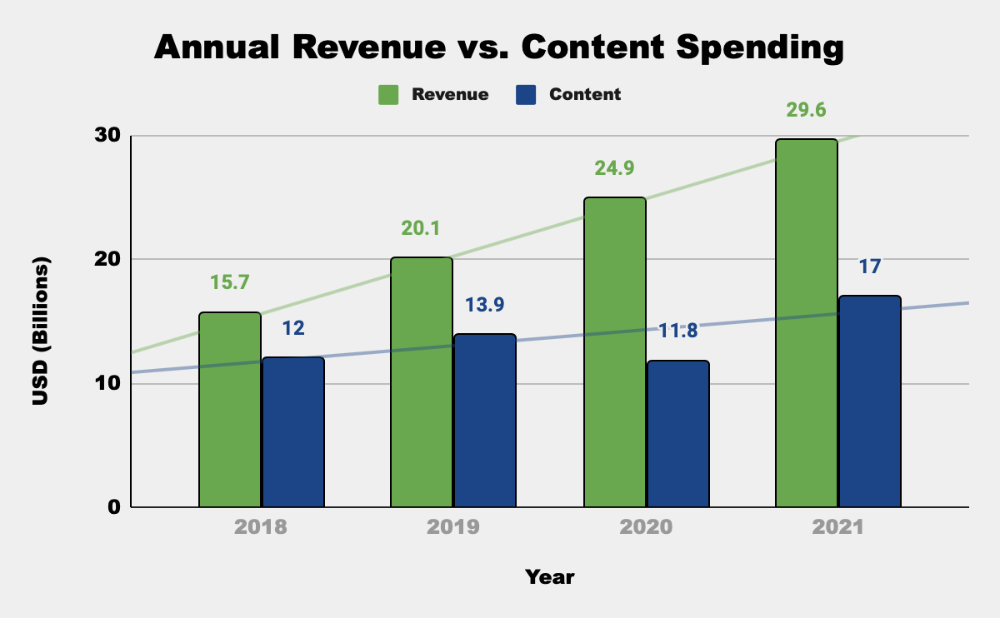
Pandemic Hits
$4b
Average increase of $4 billion annually 2018-2021.
15% decrease in content spending 2019-2020.
Content/Revenue gap went from $6.2b to $13.1b 2019-2020.
Content spending increased by 44% 2020-2021.
2021 gap remained high, although lower than 2020.
Spending less and making more.
Is this a once in a lifetime anomaly or did the pandemic create a new trend?
In the next few years will we see a growing gap in content spending vs annual revenue?

Slide 17
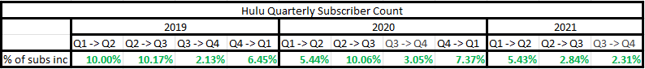
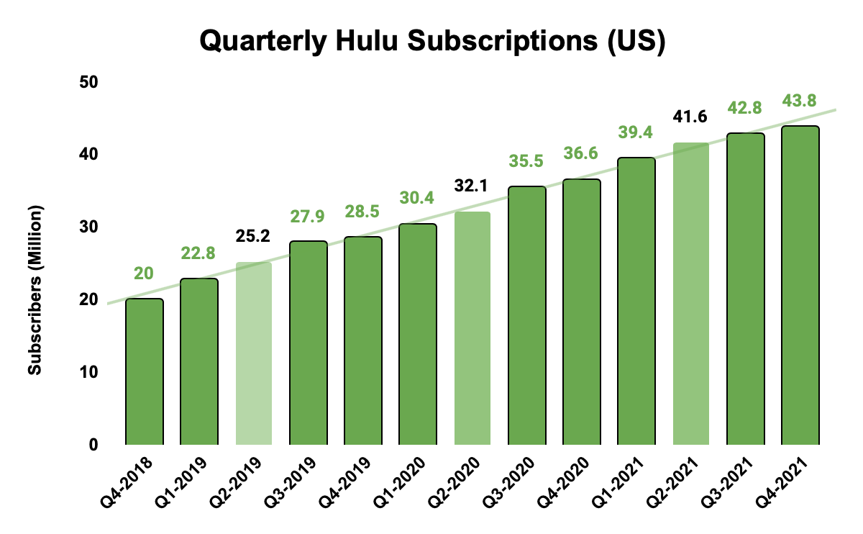
10% increase from Q2 to Q3, aligning with US’s first major lockdown.
$
6.9 million increase from 2019-2020.
27%
$
29%
9.5 million increase from 2020-2021.
2021 flattening out, not much growth.
Price raise in Q4 2019, and again in Q4 2020.

Slide 18
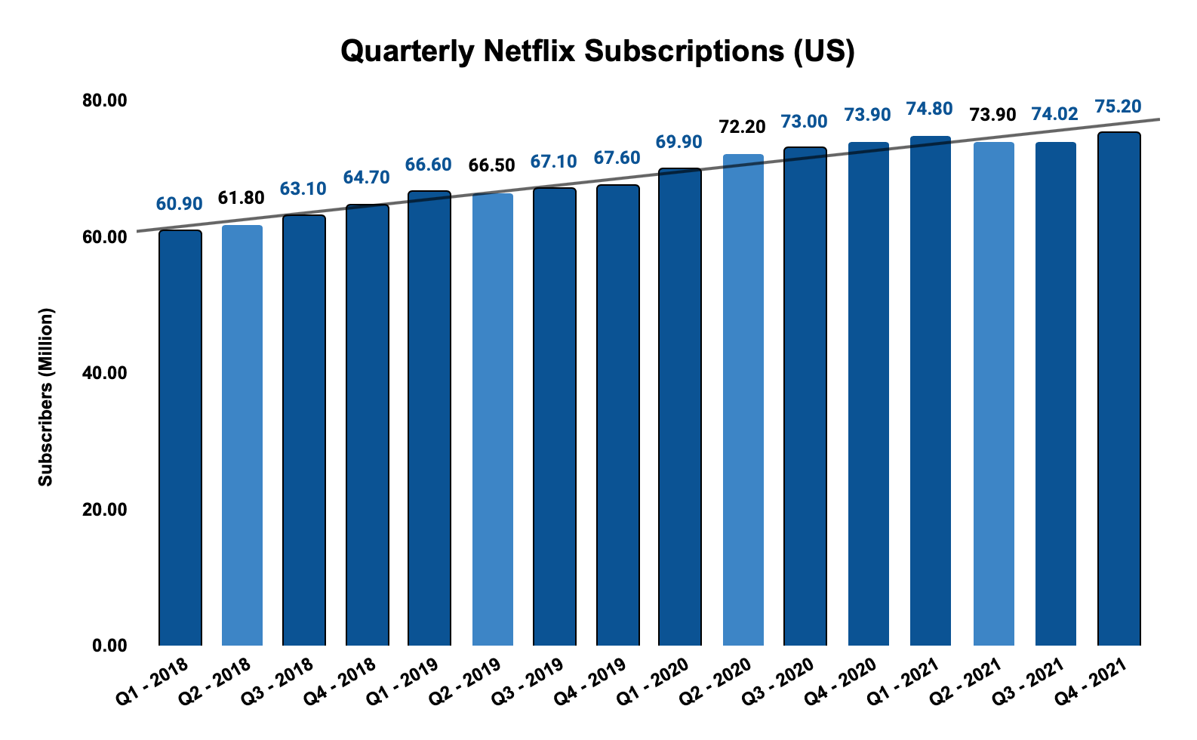
From 20’ Q2-Q3, we see an increase in
subscribers by only 1.10%
The highest increase in subscribers was from 2019 going into 2020 with a 3.41% increase, while the second highest percentage was the next quarter with a 3.24% increase.

Slide 19
Did the Covid-19 pandemic have a significant impact on the streaming service industry?

Slide 20



Hulu had a 60% annual revenue increase in 2020.
The Drama genre ranked highest in 2020, out ranking other high-scoring genres from previous years.
Netflix spent 15% less on content in 2020.
Yes!
Hulu had a 10% subscription increase during America's first lockdown.
The two streaming services spent less on content, while continuously increasing subscriptions.

